Slide 1

Data Mining Project
Predict Droughts using Weather Data
Nastaran Ashoori - Marzie Alidadi
Dr. Ghadiri
01

Slide 2
Theoretical Description
The US drought monitor is a measure of drought across the US manually created by experts using a wide range of data. This dataset’s aim is to help investigate if droughts could be predicted using only meteorological data, potentially leading to generalization of US predictions to other areas of the world.
Acknowledgements
This dataset would not exist without the open data offered by the
NASA POWER Project and the authors of the US Drought
Monitor.
02

Slide 3

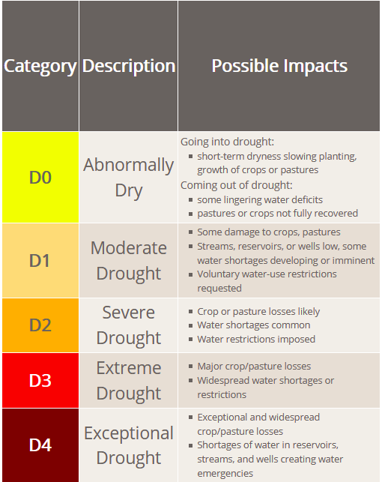
P.1:
# columns: 21
trainSet:
# rows: 19 millions with NAN
- > 2 millions
testSet:
# rows: 2 millions with NAN
-> 300 thousands
This is a classification dataset over six levels of drought, which is no drought (None in the dataset), and five drought levels shown below. Each entry is a drought level at a specific point in time in a specific US county, accompanied by the last 90 days of 18 meteorological indicators shown in the bottom of this description.
03

Slide 4
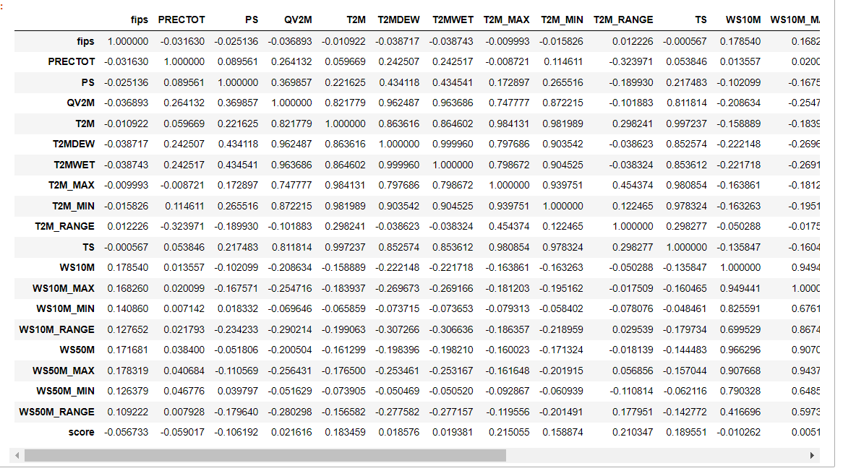
P.2
EDA : we used EDA methods for each model we created
04

Slide 5
P.3 : Pre-Processing
Normalization: we normalized our data using StandardScaler, Normalize and MinMaxScalar methods. The result of all of them were the same. So we used StandardScaler for other models.
data Balancing: we just balanced our TrainSet. but the models’ performance with this balanced data was not good. And we understood because this is TimeSeries data, we shouldn’t use resampling. For the final models we created, we left the data imbalanced.
05

Slide 6
P.4 : Search for good models
We converted the score data to integer and our problem became classification problem. So we could use classification methods to predict if there is going to be drought.
Decision Tree Classifier
Random Forest
K-Neighbors Classifier
MLP
OLS
Our data was time series so we could use time series analysis.
ARIMA
VAR
06

Slide 7
P.5:
First of all, we used different models on numerical features to predict score.
We understood the dataSet we are using on, is TimeSeries. And We should use Time as well. So we used Arima model. But it was just using time to predict the score. And this wasn’t good, because we wanted to use the meteorological features, too.
After that, we used a model called ‘MultiVariate TimeSeries Analysis’ to use time and numerical features in the same place. We thought it will be the best idea for prediction. But, it didn’t provide us good accuracy in prediction.
So we decided to use a creative method. In this method, we shifted the numerical features a row below, so that the number of features became twice.
In this place, it seems that each row is showing a duration, not an interval.
Then, by using this method for prediction, we got a proper f1-score of more than 90 percent.
07

Slide 8
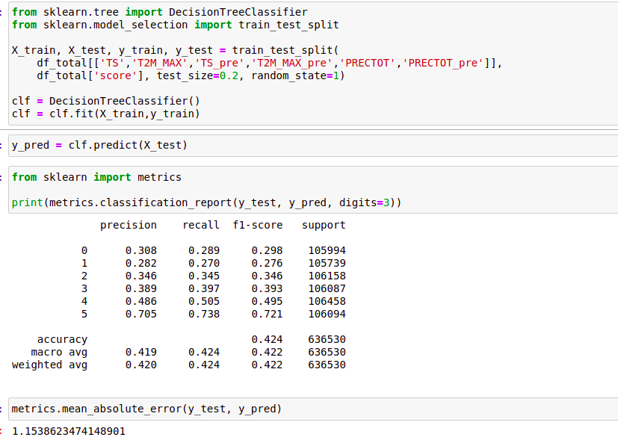
P.6:
we used the columns that had more correlation with score. Then we shifted the columns and saved them in new columns.
Then we used Decision Tree Classifier to predict the score. The results are shown in picture.
08

Slide 9
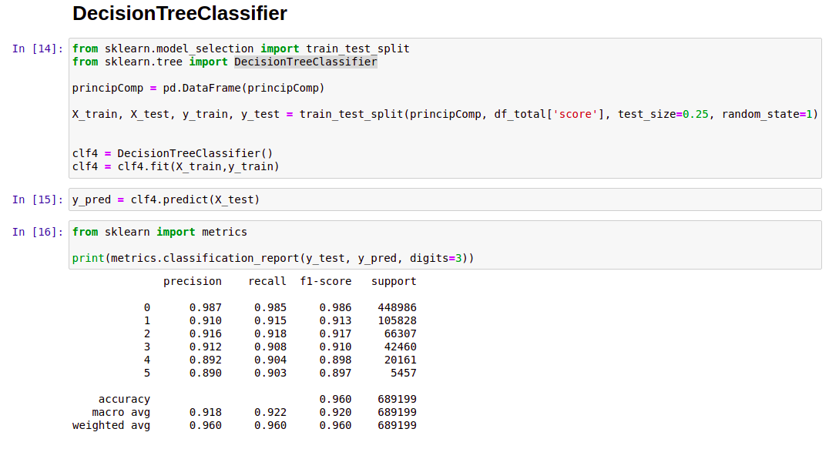
P.7:
We shifted the columns and saved them in new columns. Then we used PCA for selecting principal components.
Then we used Decision Tree Classifier to predict the score. The results are shown in picture.
09

Slide 10
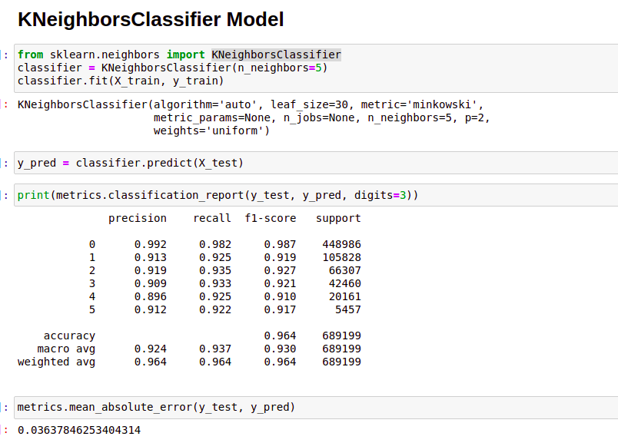
Then we used KNeighborsClassifier to predict the score. The results are shown in picture.
10

Slide 11
P.8 :
The conclusion is that if we have meteorological data over time (in this case, per week), we can predict the drought with good accuracy. If we delete the time feature, our models will not provide good results.
11

